Slide 1
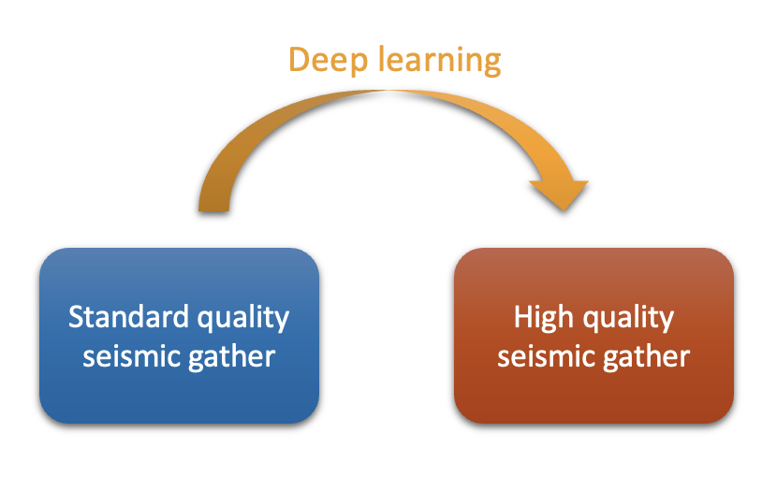


Low-to-high-quality seismic image translation using deep learning
Presented by: Ying Ting (Rhea) Lau
External supervisors from SLB UK: Dr. Rajiv Kumar, Dr. Massimiliano Vassallo
Internal supervisor from ETH Zurich: Dr. Dirk-Jan van Manen

Slide 2

Seismic processing dilemma
Raw
seismic gather
Low-cost
processing
Standard quality
seismic gather
OR
Raw
seismic gather
High-cost processing
High quality
seismic gather
Introduction
Experiment
Model evaluation
Other applications
Conclusion

Slide 3


Is there a way do high-quality seismic processing fast and cheap?
Raw
seismic gather
Low-cost
processing
High quality
seismic gather
This is our thesis objective
Introduction
Experiment
Model evaluation
Other applications
Conclusion

Slide 4

Low-to-high-quality seismic image translation 2-step workflow
Selected raw
seismic gathers
All raw
seismic gathers
Low-cost processing
High-cost processing
Low-cost processing
Standard quality
seismic gathers
DL model training
High quality
seismic gathers
Standard quality
seismic gathers
Apply DL model
High quality
seismic gathers
Step 1: Train a deep learning (DL) model with selected seismic gathers from both low-cost and high-cost processing
Step 2: Applied the trained DL model to all low-cost processed seismic gathers
Introduction
Experiment
Model evaluation
Other applications
Conclusion

Slide 5
To test this workflow, we took seismic interpolation as an example
Introduction
Experiment
Model evaluation
Other applications
Conclusion

Slide 6


MPFI Matching Pursuit Fourier Interpolation
TDRI Time Domain Radon Interpolation
Interpolate traces by matching data iteratively in the Fourier domain
Interpolate traces by matching data iteratively in the Radon domain (intercept time and dip)
Standard industry solution, affordable
More robust to aliasing, works on steeply
dipping events, overall better quality
Limited robustness to spatial aliasing
Significantly more expensive

Slide 7
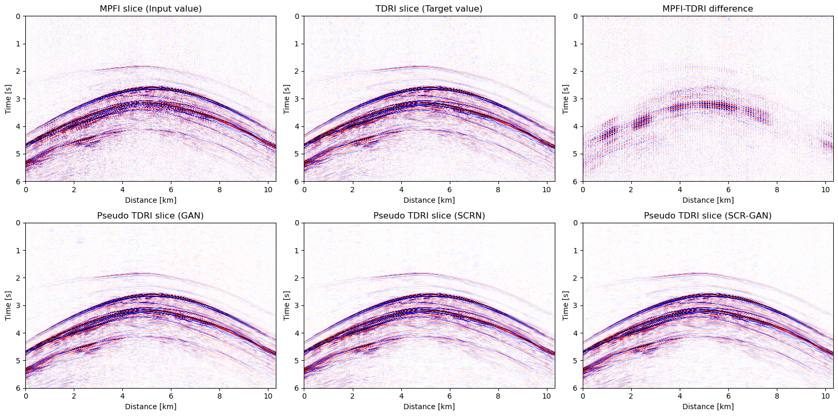
Gulf of Mexico dataset
Introduction
Experiment
Model evaluation
Other applications
Conclusion
Notes:
MPFI are more subjected to interpolation artifacts

Slide 8
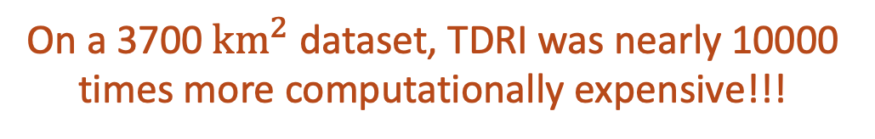
Seismic interpolation dilemma
CPU time: 13 hours
All raw
seismic gathers
3D MPFI
Standard quality
seismic gathers
OR
All raw
seismic gathers
3D TDRI
High quality
seismic gathers
CPU time: 127,294 hours
On a 3700 ${km}^{2}$ dataset, TDRI was nearly 10000 times more computationally expensive!!!
Introduction
Experiment
Model evaluation
Other applications
Conclusion
Notes:
On 3700 km2 gulf of Mexico dataseet

Slide 9
MPFI-to-TDRI seismic image translation 2-step workflow
One raw
seismic gather
All raw
seismic gathers
3D MPFI
3D TDRI
3D MPFI
MPFI
seismic gather
DL model training
TDRI
seismic gather
MPFI
seismic gathers
Apply DL model
Pseudo TDRI
seismic gathers
Step 1: Train a deep learning (DL) model with ONE small subset of data from both MPFI and TDRI
Step 2: Applied the trained DL model to the whole dataset after MPFI to obtain pseudo TDRI results
Introduction
Experiment
Model evaluation
Other applications
Conclusion

Slide 10
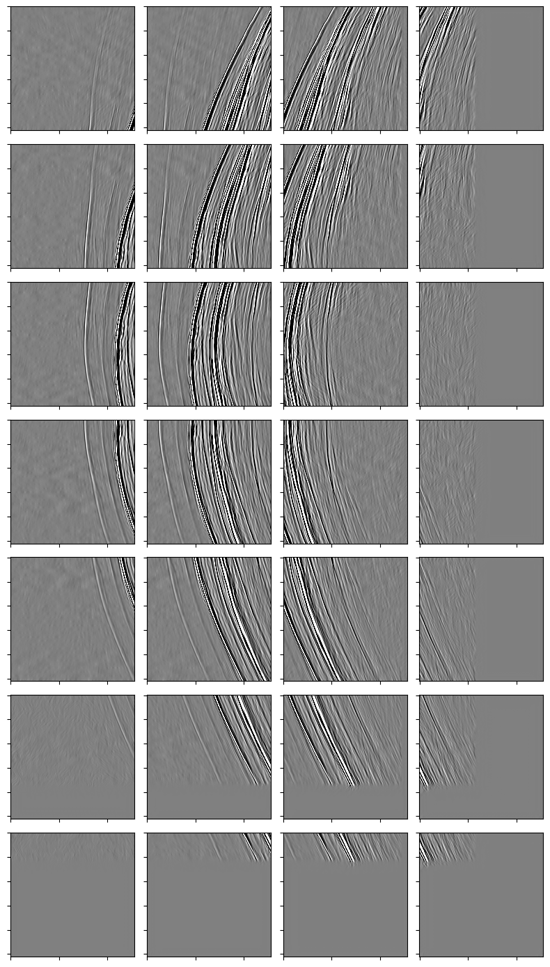
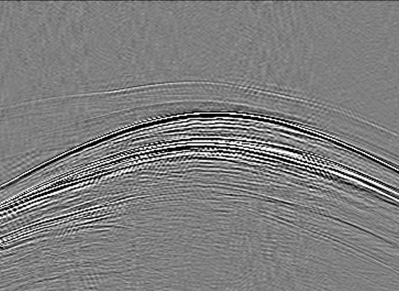
Create training data
3D Seismic Volume
Inline
601
Patches are 50% overlapping in both directions
Edge patches are excluded in the training and validation set, but are included in the test set
Crossline
256
500
826
. . . . . .
256
2D Patch
Edge Patch
Time
. . .
2D Seismic Slices
Zero padding
2D Seismic Slice
. . .
2D Seismic Slice
Edge Patch
Edge Patch
. . . . . .
Zero padding
6010 paired MPFI-TDRI patches as our data for model training
Introduction
Experiment
Model evaluation
Other applications
Conclusion
Notes:
Receiver spaced 1000m source 50m, ideally we used both crossline and inlin
Edge patches has a lot of zero, maping zero to zero instead of amplitude to ampltide, remove instability in learning processes
ed

Slide 11
Model training
We experimented 3 deep learning models:
Generative Adversarial Network (GAN)
Swin Transformer Convolutional Residual Network (SCRN)
Swin Transformer Convolutional Residual Generative Adversarial Network (SCR-GAN)
Models are trained with Nvidia A100 GPUs
Hyperparameters are carefully selected for each model
Introduction
Experiment
Model evaluation
Other applications
Conclusion
Notes:
Initially the objective is to use GAN, I came up with the idea of SCRN, this is contribution

Slide 12


What is GAN? Generative Adversarial Network
MPFI Images
Embedding space
Generator
The Artist
Fake Images
Real Images
Pseudo TDRI Images
TDRI Images
Discriminator
The Critic
Model 1
Real or Fake
Learn!
Loss and gradient backpropagation

Slide 13
Generator and discriminator learn the features using convolutional neural network (CNN)
8 | -3 | 9 | -2
1 | 2 | 4 | 0
0 | 5 | -7 | 10
0 | 5 | 3 | 1
0 | -1
5 | 2
12 | 22
5 | 7
Kernel filter
Output data
Input data
Convolutional layer involves applying a kernel filter over the input data and computing the dot product between the filter and the covered input area.
CNN captures local features well
Introduction
Experiment
Model evaluation
Other applications
Conclusion

Slide 14
Generator and discriminator learn the features using convolutional neural network (CNN)
8 | -3 | 9 | -2
1 | 2 | 4 | 0
0 | 5 | -7 | 10
0 | 5 | 3 | 1
0 | -1
5 | 2
12 | 22
5 | 7

Slide 15
GAN architecture
Input
G Output
Reduction block
Convolution
Transposed convolution
Expansion block
Convolution
Reduction block
Concatenation
Expansion block
Transposed convolution
Batch normalisation
Reduction block
Concatenation
Expansion block
Batch normalisation
Activation function
Repeat until the dimension becomes 1
Repeat until reaches the input dimension
Activation function
Dropout
Dropout
Reduction block
Concatenation
Expansion block
Flatten
Linear
D Output
Introduction
Experiment
Model evaluation
Other applications
Conclusion

Slide 16
Input
What is SCRN? Swin Transformer Convolutional Residual Network
Convolution
CNN block
Convolution
Convolution
Batch normalisation
x3
Split channels
ReLU
ViT
block
CNN
block
Repeat according to the layer configuration
Feature fusion block (FFB)
Combine channels
Convolution
Convolution
Model 2
Convolution
Output

Slide 17







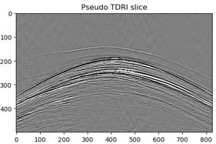
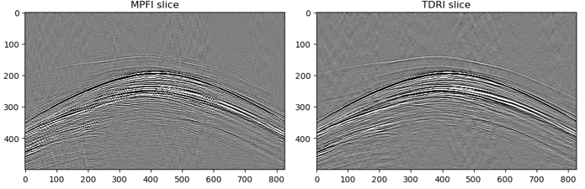
What is ViT? Vision Transformer
Patch Embedding
Encoder
Decoder
Patch Un-embedding
Patch Embedding
Encoder
Decoder
Patch Un-embedding
Extract local feature of each patch
Analyse relationships between patches and capture the overall structure of the target
Decode using the feature learnt in the encoding part
Reshape the decoder output into the image format
While CNN captures local features well, ViT captures global features well

Slide 18
Reduction block
Convolution
How about SCRN+GAN?
Batch normalisation
Input
Activation function
Dropout
Convolution
Convolution
Reduction block
Feature fusion block
Feature fusion block (FFB)
Reduction block
Feature fusion block
Convolution
Repeat until the dimension becomes 1
Repeat according to
block configuration
Split channels
Reduction block
Feature fusion block
ViT
block
CNN
block
Flatten
Feature fusion block
Linear
Convolution
Model 3
D Output
G Output
Combine channels
Convolution
Convolution
Notes:
I decide, this is the innovative part, this doesn’t exisit
Expand this part

Slide 19
SCR-GAN
I proposed building a new architecture combining both GAN and SCRN
The presence of generator and discriminator makes the model more robust
ViT and CNN allow the model to capture both small scale features and long-range pixels relevant
Generator
Discriminator
ViT
block
CNN
block
Introduction
Experiment
Model evaluation
Other applications
Conclusion

Slide 20
Model evaluation metrics:
Performance on seen data
(Training dataset)
Training SNR
Training Loss
Generator/
Discriminator/
SCRN Loss
Signal-to-Noise Ratio
(SNR)
Validation SNR
Validation Loss
Lower loss and higher SNR indicates better model performance.
Performance on unseen data
(Validation dataset)
Introduction
Experiment
Model evaluation
Other applications
Conclusion
Notes:
Quantitatively how we are doing, loss how well we are doing on the netwaork optimiser
SNR could be misleading as it can be high by matching the high amplitude

Slide 21
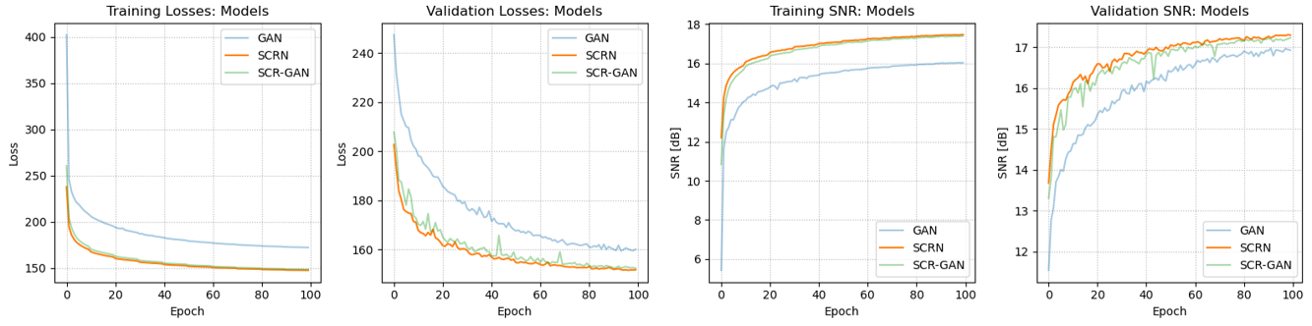
Let’s compare our three models:
SCRN outperformed the other models
with the lowest loss and highest SNR.
Introduction
Experiment
Model evaluation
Other applications
Conclusion
Notes:
Can use table

Slide 22
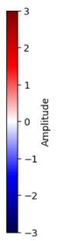
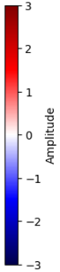
How about the image translation performance? Let’s test it on an unseen common receiver gather

Slide 23
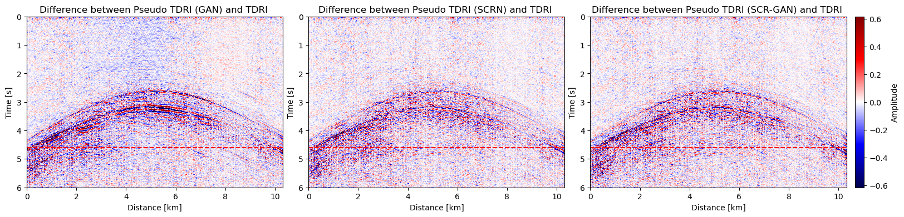
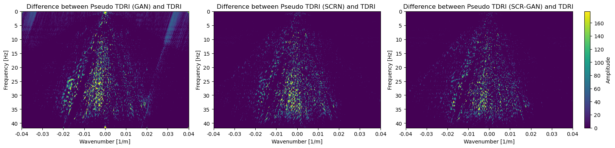
Analyse the difference between the target value and reconstructed value
t = 4.6s
t = 4.6s
t = 4.6s
Edge patches are excluded in the training and validation set, but are included in the test set

Slide 24
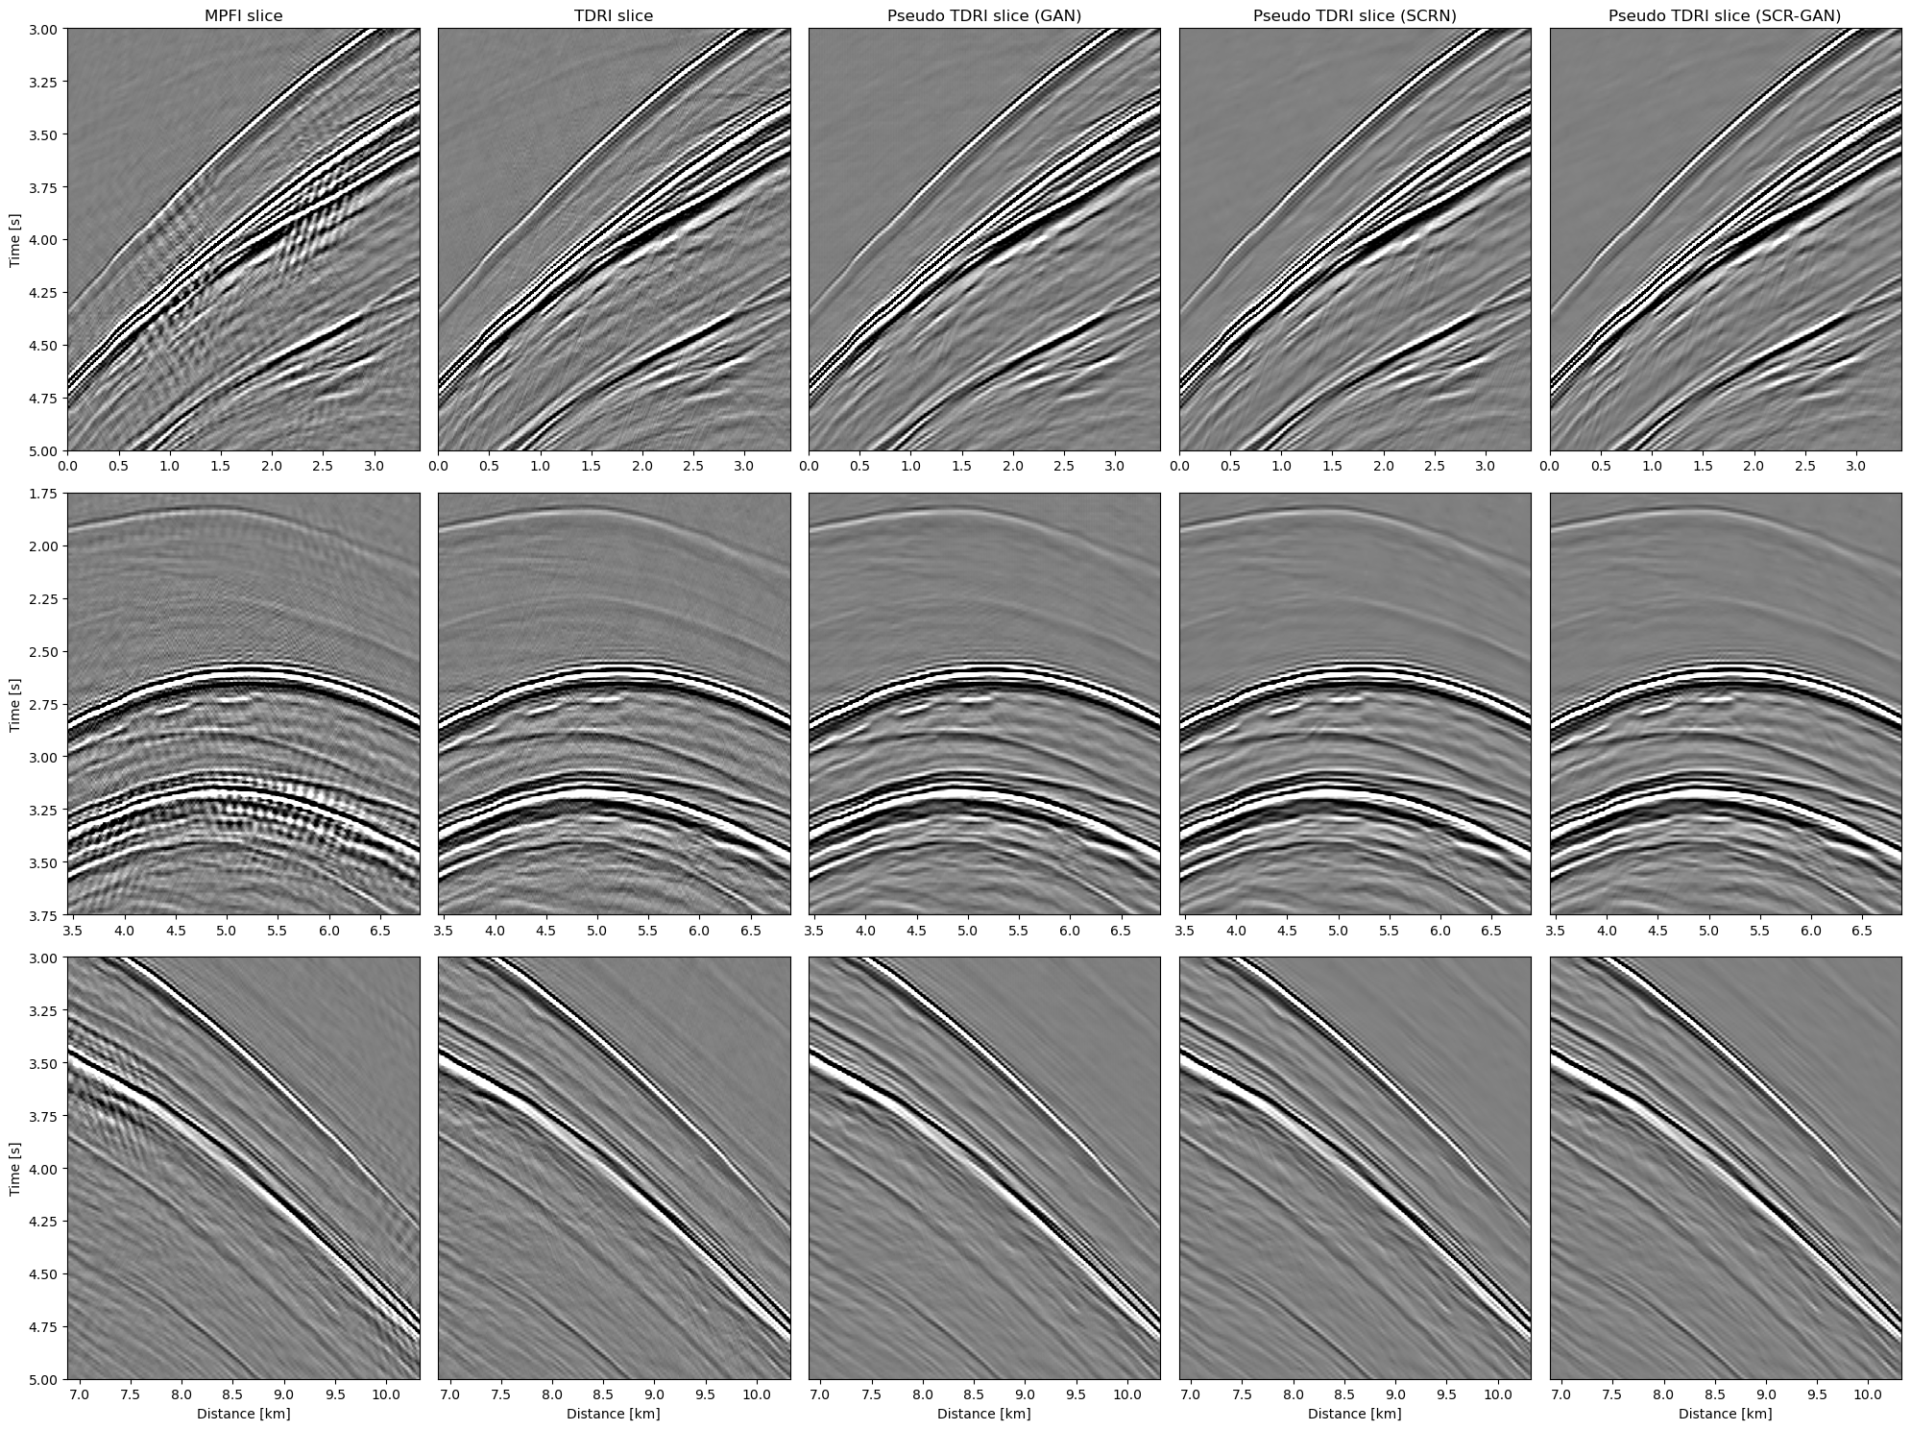
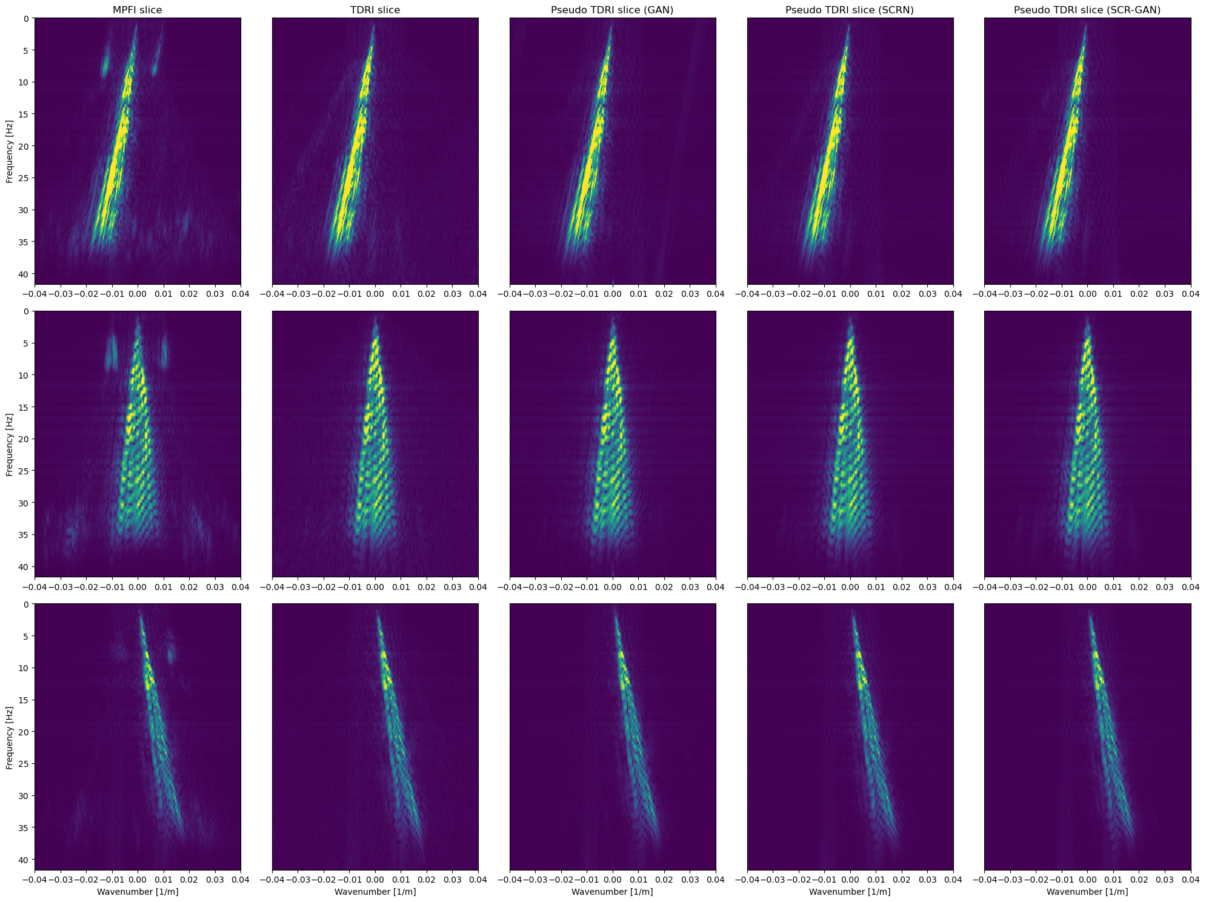
Analyse the reconstruction (1/3)
MPFI slice TDRI slice Pseudo TDRI (GAN) Pseudo TDRI (SCRN) Pseudo TDRI (SCRGAN)
Introduction
Experiment
Model evaluation
Other applications
Conclusion
Notes:
Remove cross

Slide 25
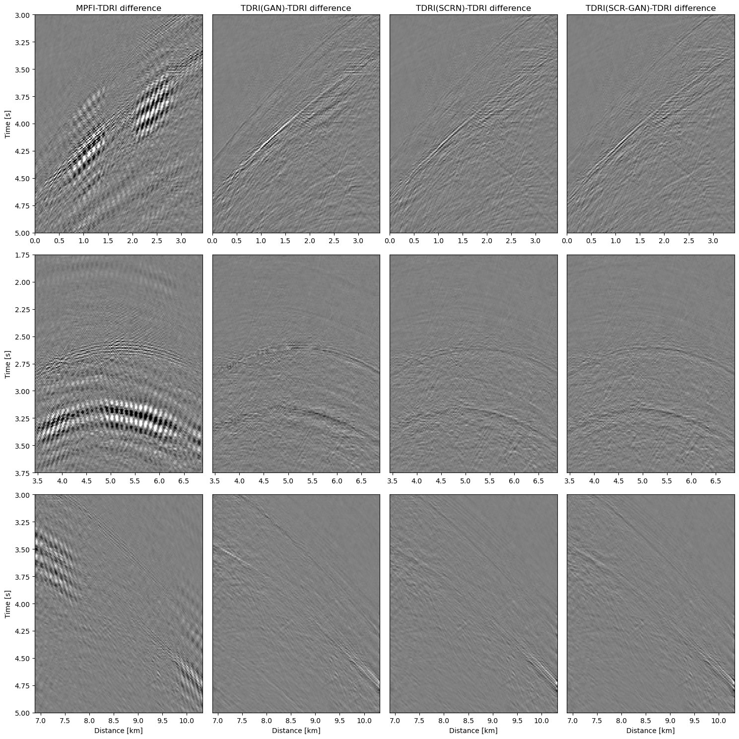
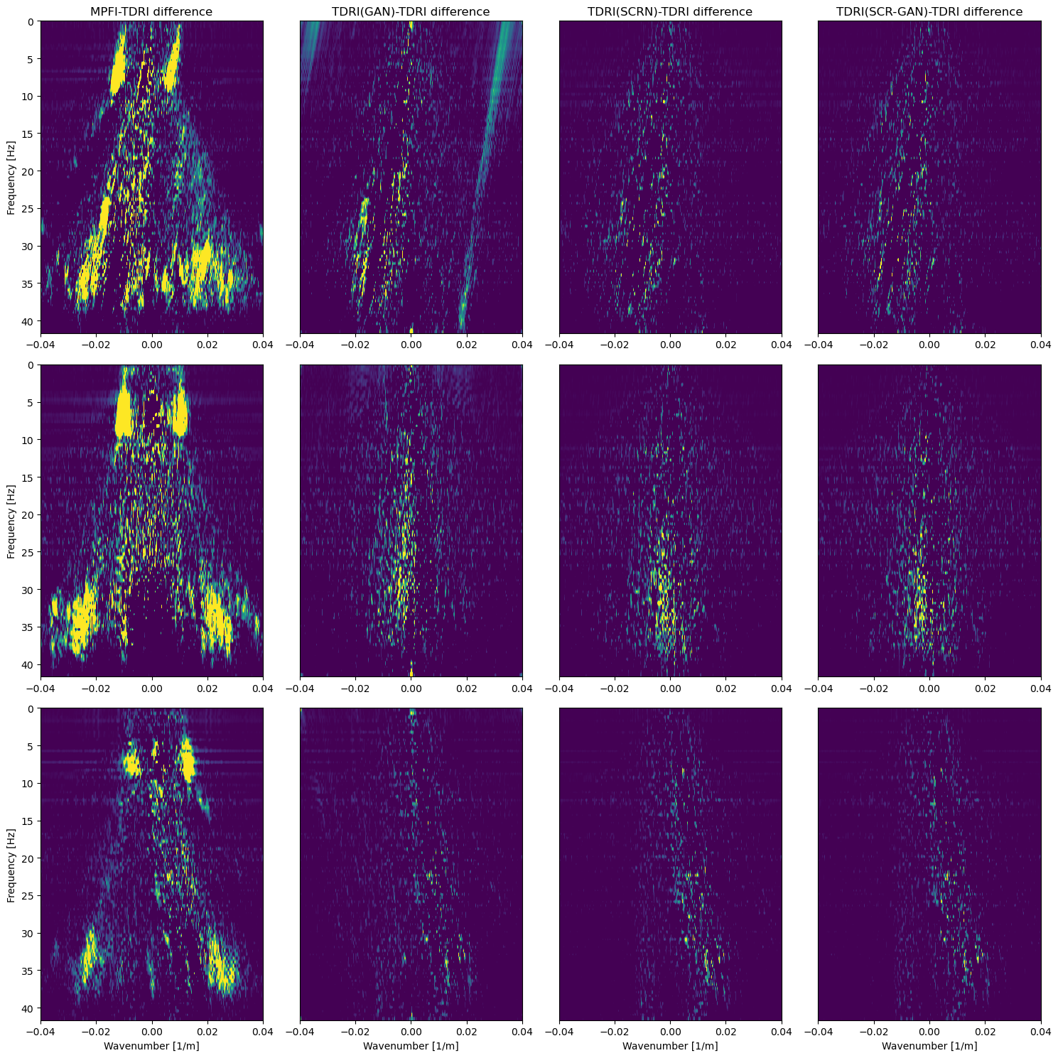
Difference with the target value (1/3)
MPFI - TDRI TDRI (GAN) - TDRI TDRI (SCRN) - TDRI TDRI (SCRGAN) - TDRI
Notes:
Don’t circle it
Scrn based model did recognise aliasing better

Slide 26
Analyse the reconstruction (2/3)
MPFI slice TDRI slice Pseudo TDRI (GAN) Pseudo TDRI (SCRN) Pseudo TDRI (SCRGAN)
Introduction
Experiment
Model evaluation
Other applications
Conclusion
Notes:
TDRI is not physics blind, knows the dip range

Slide 27
Difference with the target value (2/3)
MPFI - TDRI TDRI (GAN) - TDRI TDRI (SCRN) - TDRI TDRI (SCRGAN) - TDRI

Slide 28
Analyse the reconstruction (3/3)
MPFI slice TDRI slice Pseudo TDRI (GAN) Pseudo TDRI (SCRN) Pseudo TDRI (SCRGAN)
Introduction
Experiment
Model evaluation
Other applications
Conclusion

Slide 29
Difference with the target value (3/3)
MPFI - TDRI TDRI (GAN) - TDRI TDRI (SCRN) - TDRI TDRI (SCRGAN) - TDRI

Slide 30
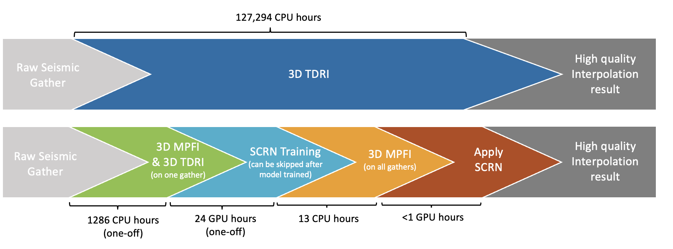
Conclusion on our experiment
SCRN performs MPFI-TDRI image translation the best
Reconstructed TDRI images with high resemblance and denoising
Once trained, the SCRN model could produce TDRI quality result through the low-to-high quality translation workflow, with computational costs comparable to MPFI processing.
Introduction
Experiment
Model evaluation
Other applications
Conclusion

Slide 31
With new datasets available
Apply transfer learning: input new dataset to the trained model
After many updates, the network will be generalised to most area
Then we can exclude the training stage and apply SCRN directly
X
X
Introduction
Experiment
Model evaluation
Other applications
Conclusion
Notes:
After many update, the network will be generalised to all are, transfer learning
For gulf of mexico

Slide 32
Our ultimate goal is to apply this 2-step workflow on different seismic processing technologies, to get high quality result with low cost
Now we have proven the feasibility of this workflow on seismic interpolation
Step 1
Selected raw
seismic gathers
Step 2
All raw
seismic gathers
Low-cost processing
High-cost processing
Low-cost processing
Standard quality
seismic gathers
DL model training
High quality
seismic gathers
Standard quality
seismic gathers
Apply DL model
High quality
seismic gathers
Introduction
Experiment
Model evaluation
Other applications
Conclusion

Slide 33
Other applications example: Ocean bottom node (OBN) demultiple
OBN demultiple is typically achieved by deconvolving up-going and down going wavefield
Up-down deconvolution (UDD) is cheaper but requires a flat seabed
Multi-dimensional deconvolution (MDD) overcomes this limitation but involves severely higher costs
Step 1
Raw
seismic gather
Step 2
Raw
seismic gather
UDD
MDD
UDD
Low-cost
processing
High-cost
processing
Low-cost
processing
UDD results
DL model training
MDD results
UDD results
Apply DL model
MDD results
Introduction
Experiment
Model evaluation
Other applications
Conclusion
Notes:
MDD requires stable interpolation across sparsely sampled receivers, significantly increasing the computational burden and complexity compared to UDD, which operates on common receiver gathers without such interpolation

Slide 34
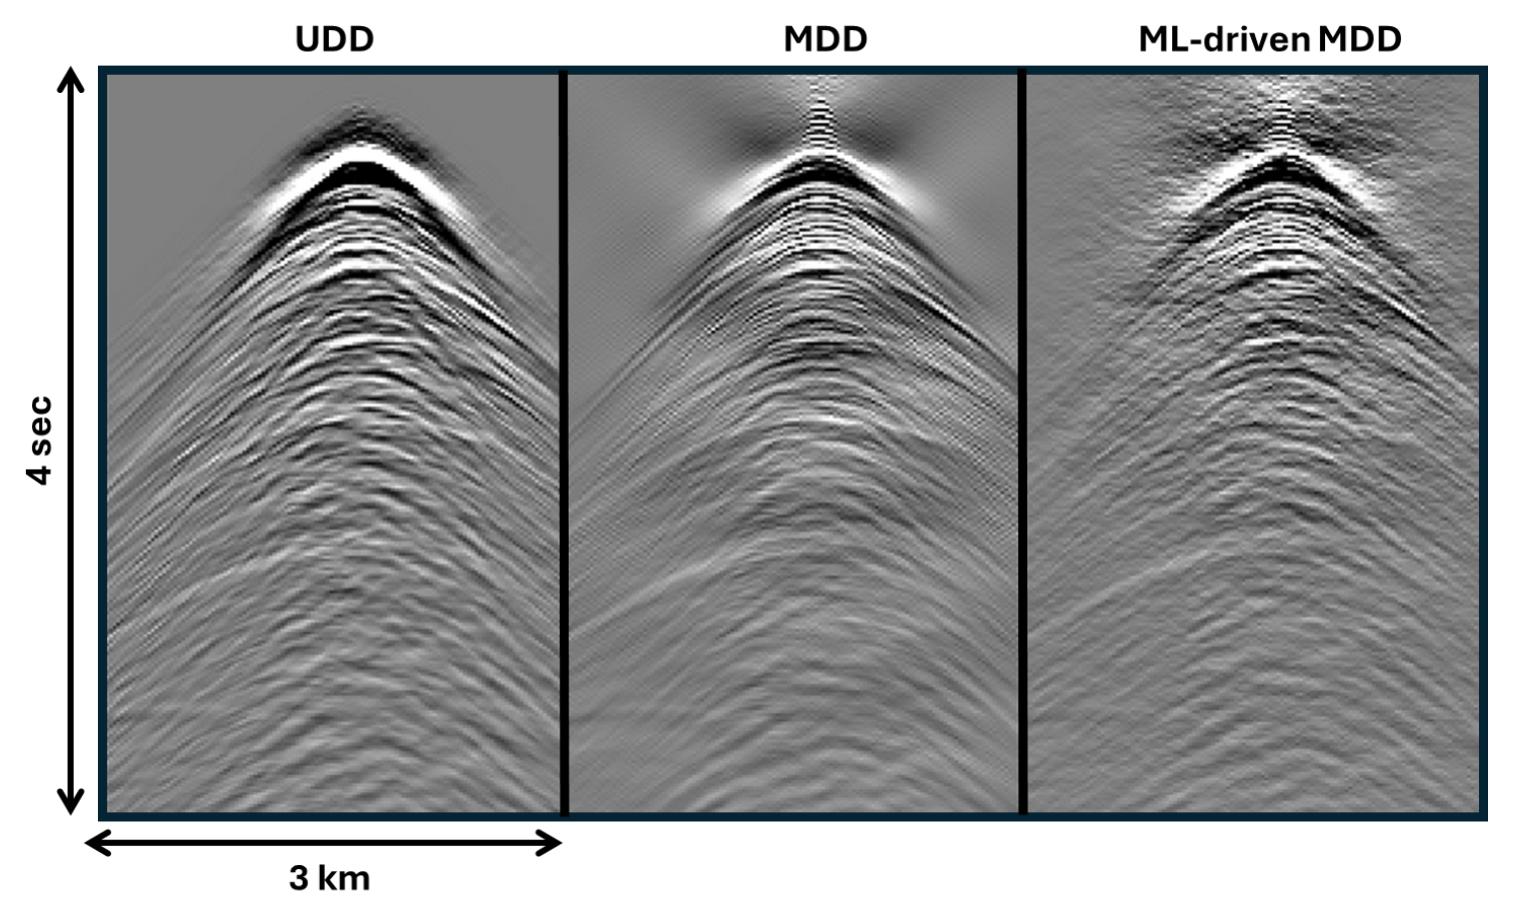
UDD-MDD translation
We experimented training the same SCRN model used for MPFI-TDRI experiment on the UDD-MDD dataset
Our preliminary results make us optimistic that UDD-MDD translation can be achieved with optimised hyperparameters
Introduction
Experiment
Model evaluation
Other applications
Conclusion

Slide 35
Thesis recap
Aim to upscale result from an affordable processing technology
Focus on interpolation, we explored the feasibility of the 2-step workflow
Prototyped and tested 3 deep learning models
Two state-of-the-art architecture from recent literature: GAN, SCRN
One novel architecture: SCR-GAN (patent application submitted)
Generalised to other applications, such as demultiple (patent application submitted)
Introduction
Experiment
Model evaluation
Other applications
Conclusion

Slide 36
Is there a way do high-quality seismic processing fast and cheap?
Raw
seismic gather
Low-cost
processing
High quality
seismic gather
Yes, there is!
By mapping low-cost processed data to high-quality results with deep learning.
Introduction
Experiment
Model evaluation
Other applications
Conclusion

Slide 37

Low-to-high-quality seismic image translation using deep learning
Presented by: Ying Ting (Rhea) Lau
External supervisors from SLB UK: Dr. Rajiv Kumar, Dr. Massimiliano Vassallo
Internal supervisor from ETH Zurich: Dr. Dirk-Jan van Manen

Slide 38
Limitations
Garbage in, garbage out
The quality of image translation is capped by the quality of the data, if the data have noises, then the model will also learn them and output noises.
Limited data, limited generalisation
Our model is trained exclusive to the Gulf of Mexico dataset. Getting pairs of MPFI and TDRI datasets are costly.

Slide 39
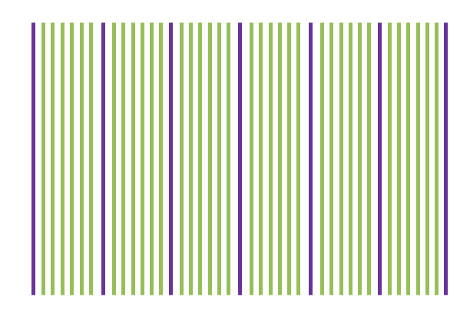
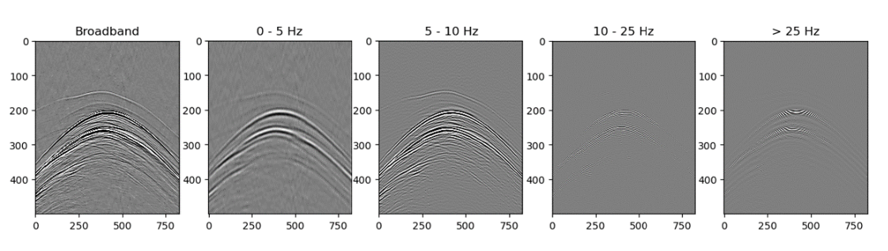
Improvements
Weighting key traces for training
Expand the training data
Increase dataset variety through frequency augmentation

Slide 40
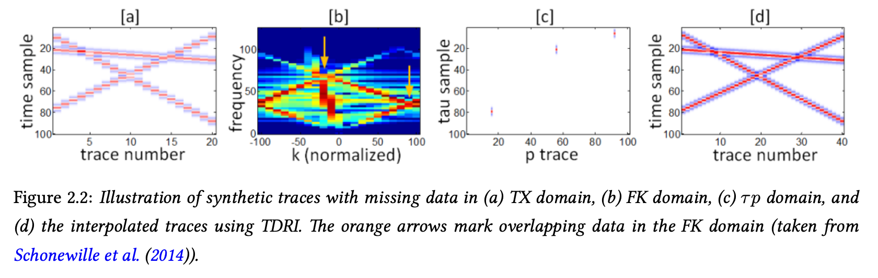
Domains
Seismic wavelet’s energy is compact in time and spreads across frequencies,
such that the signal often appears as sparse, concentrated in a narrow range of τ values and specific dip, making it easier to distinguish from noise than in the frequency domain.

Slide 41
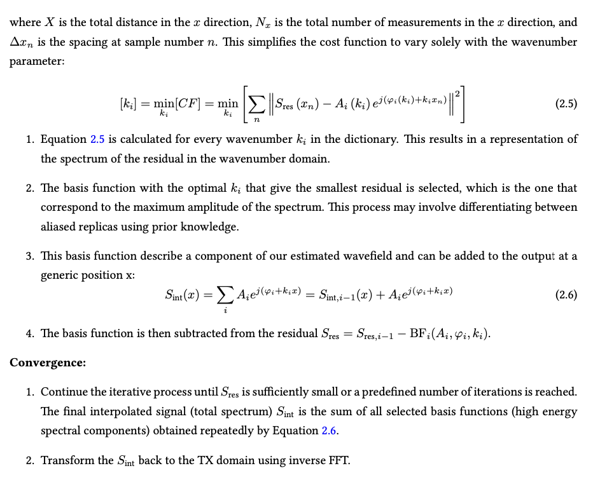
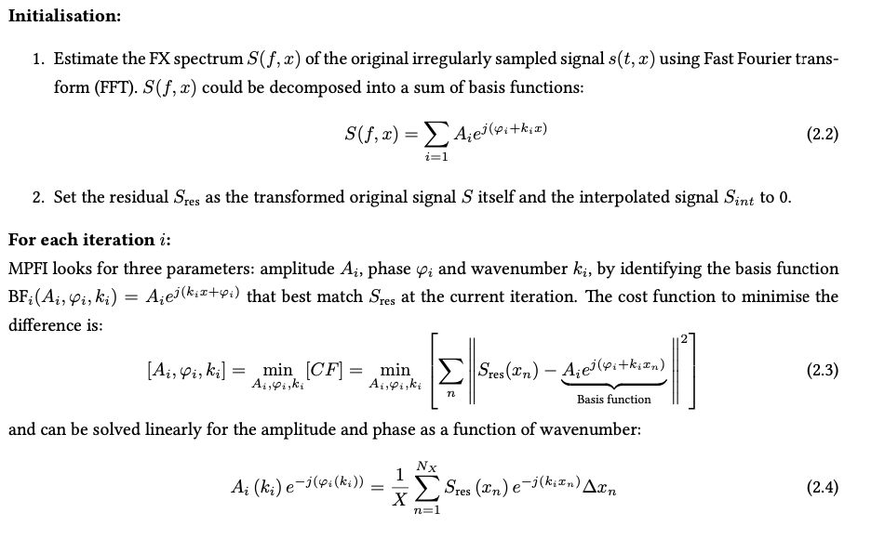
MPFI algorithm

Slide 42
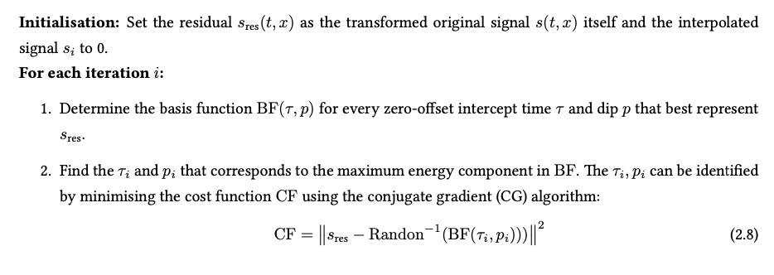
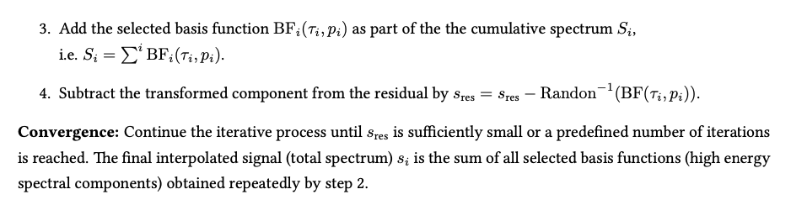
TDRI algorithm

Slide 43
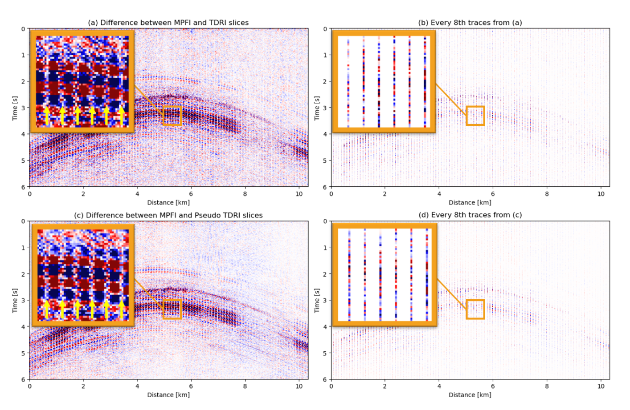
Weighting key traces

Slide 44
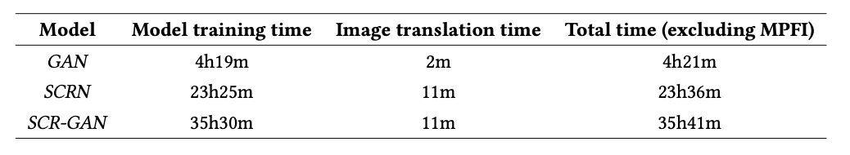
Model training time

Slide 45
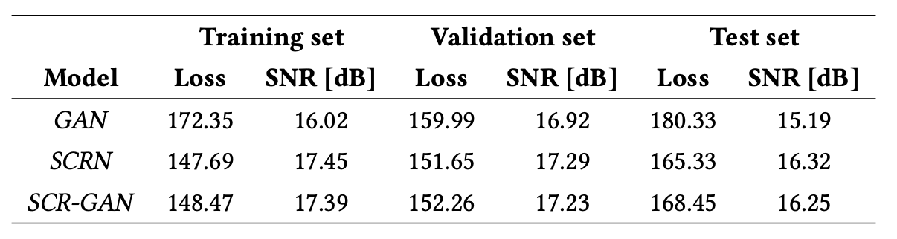
Model performance

Slide 46
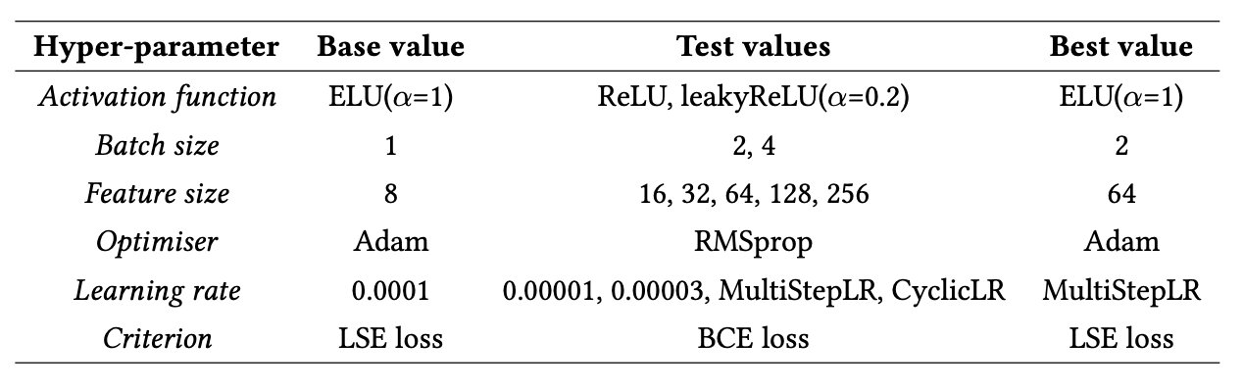
Model optimisation (GAN)

Slide 47
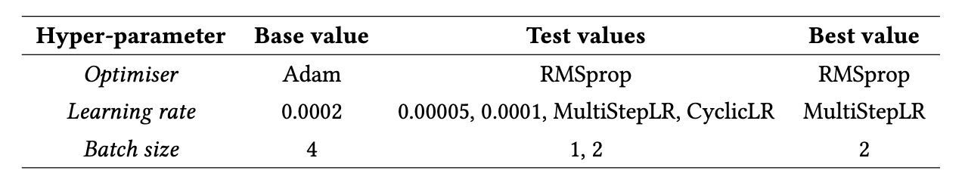
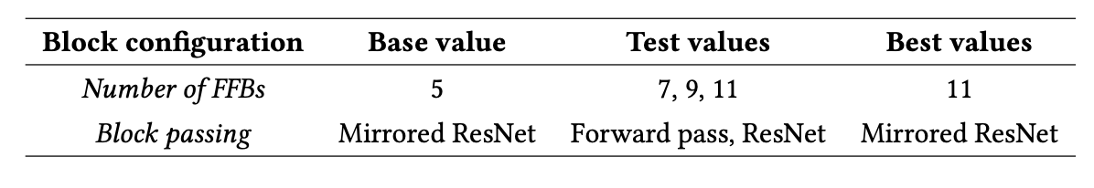
Model optimisation (SCRN)

Slide 48
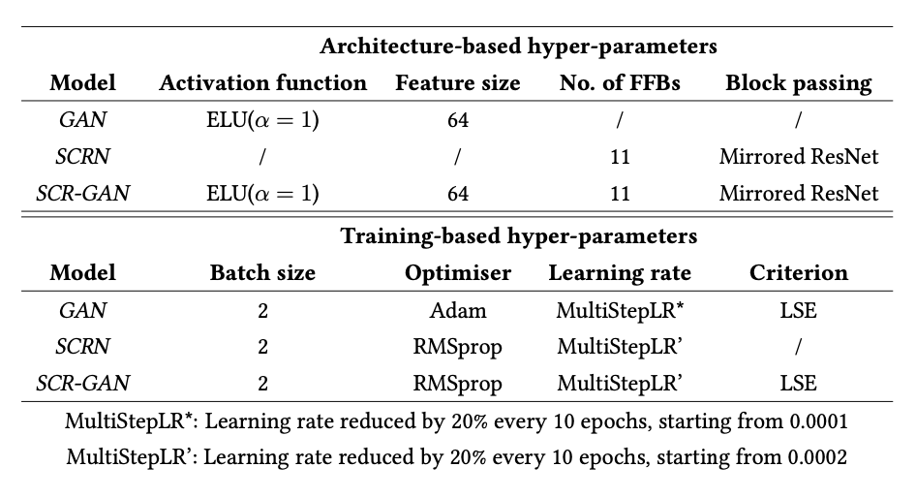
Model parameters

